Slide 1
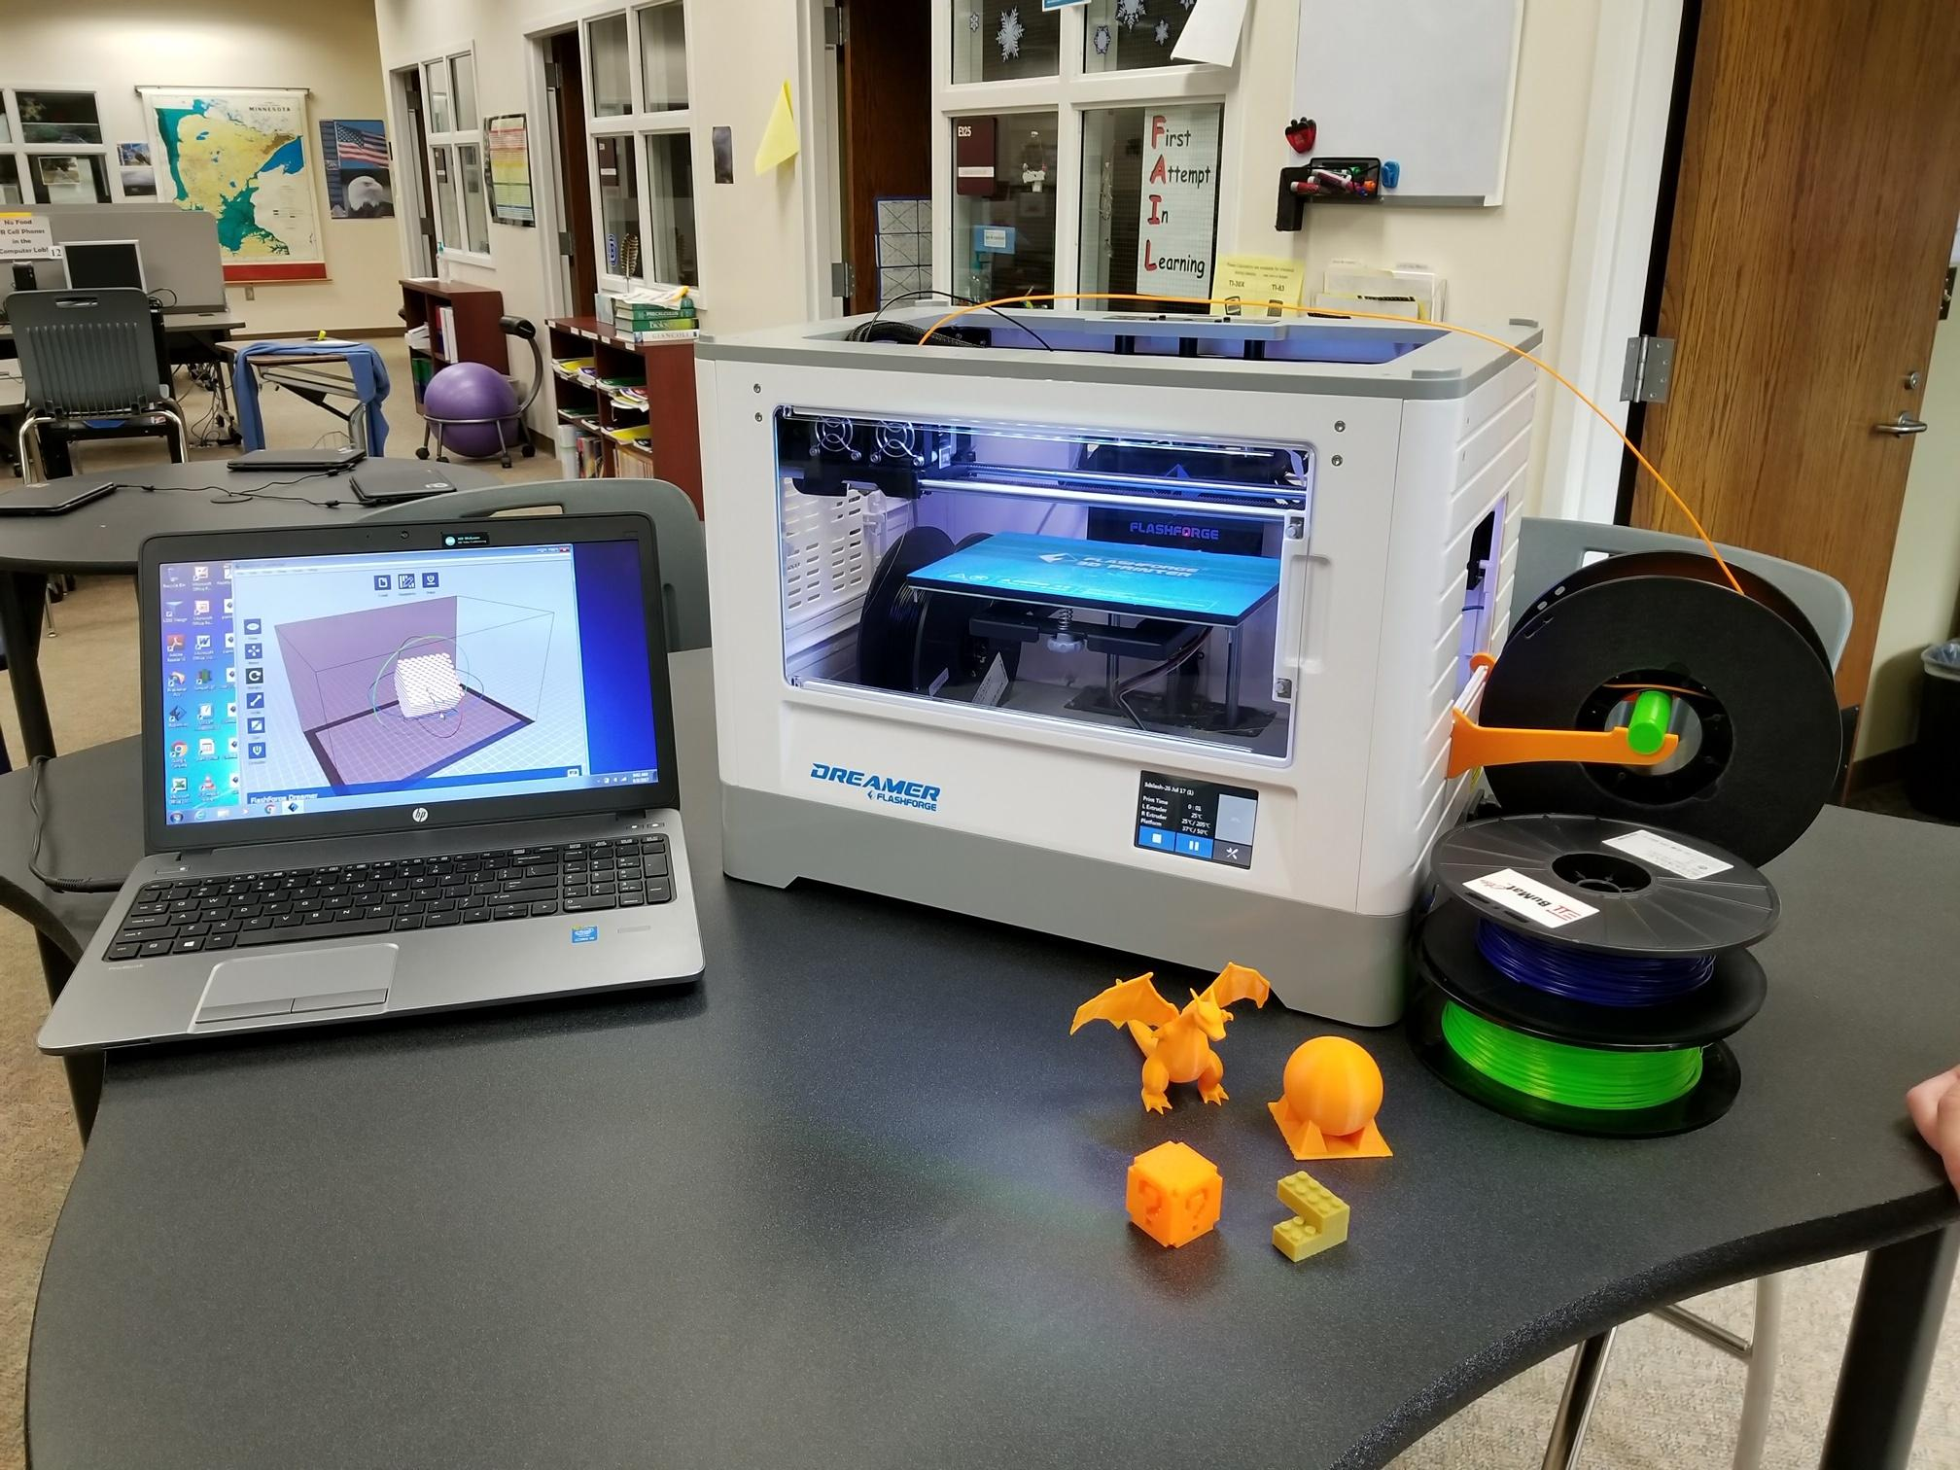
3D Printing with Chromebooks
Steven Lendobeja Brainerd Public Schools Brainerd MN

Slide 2
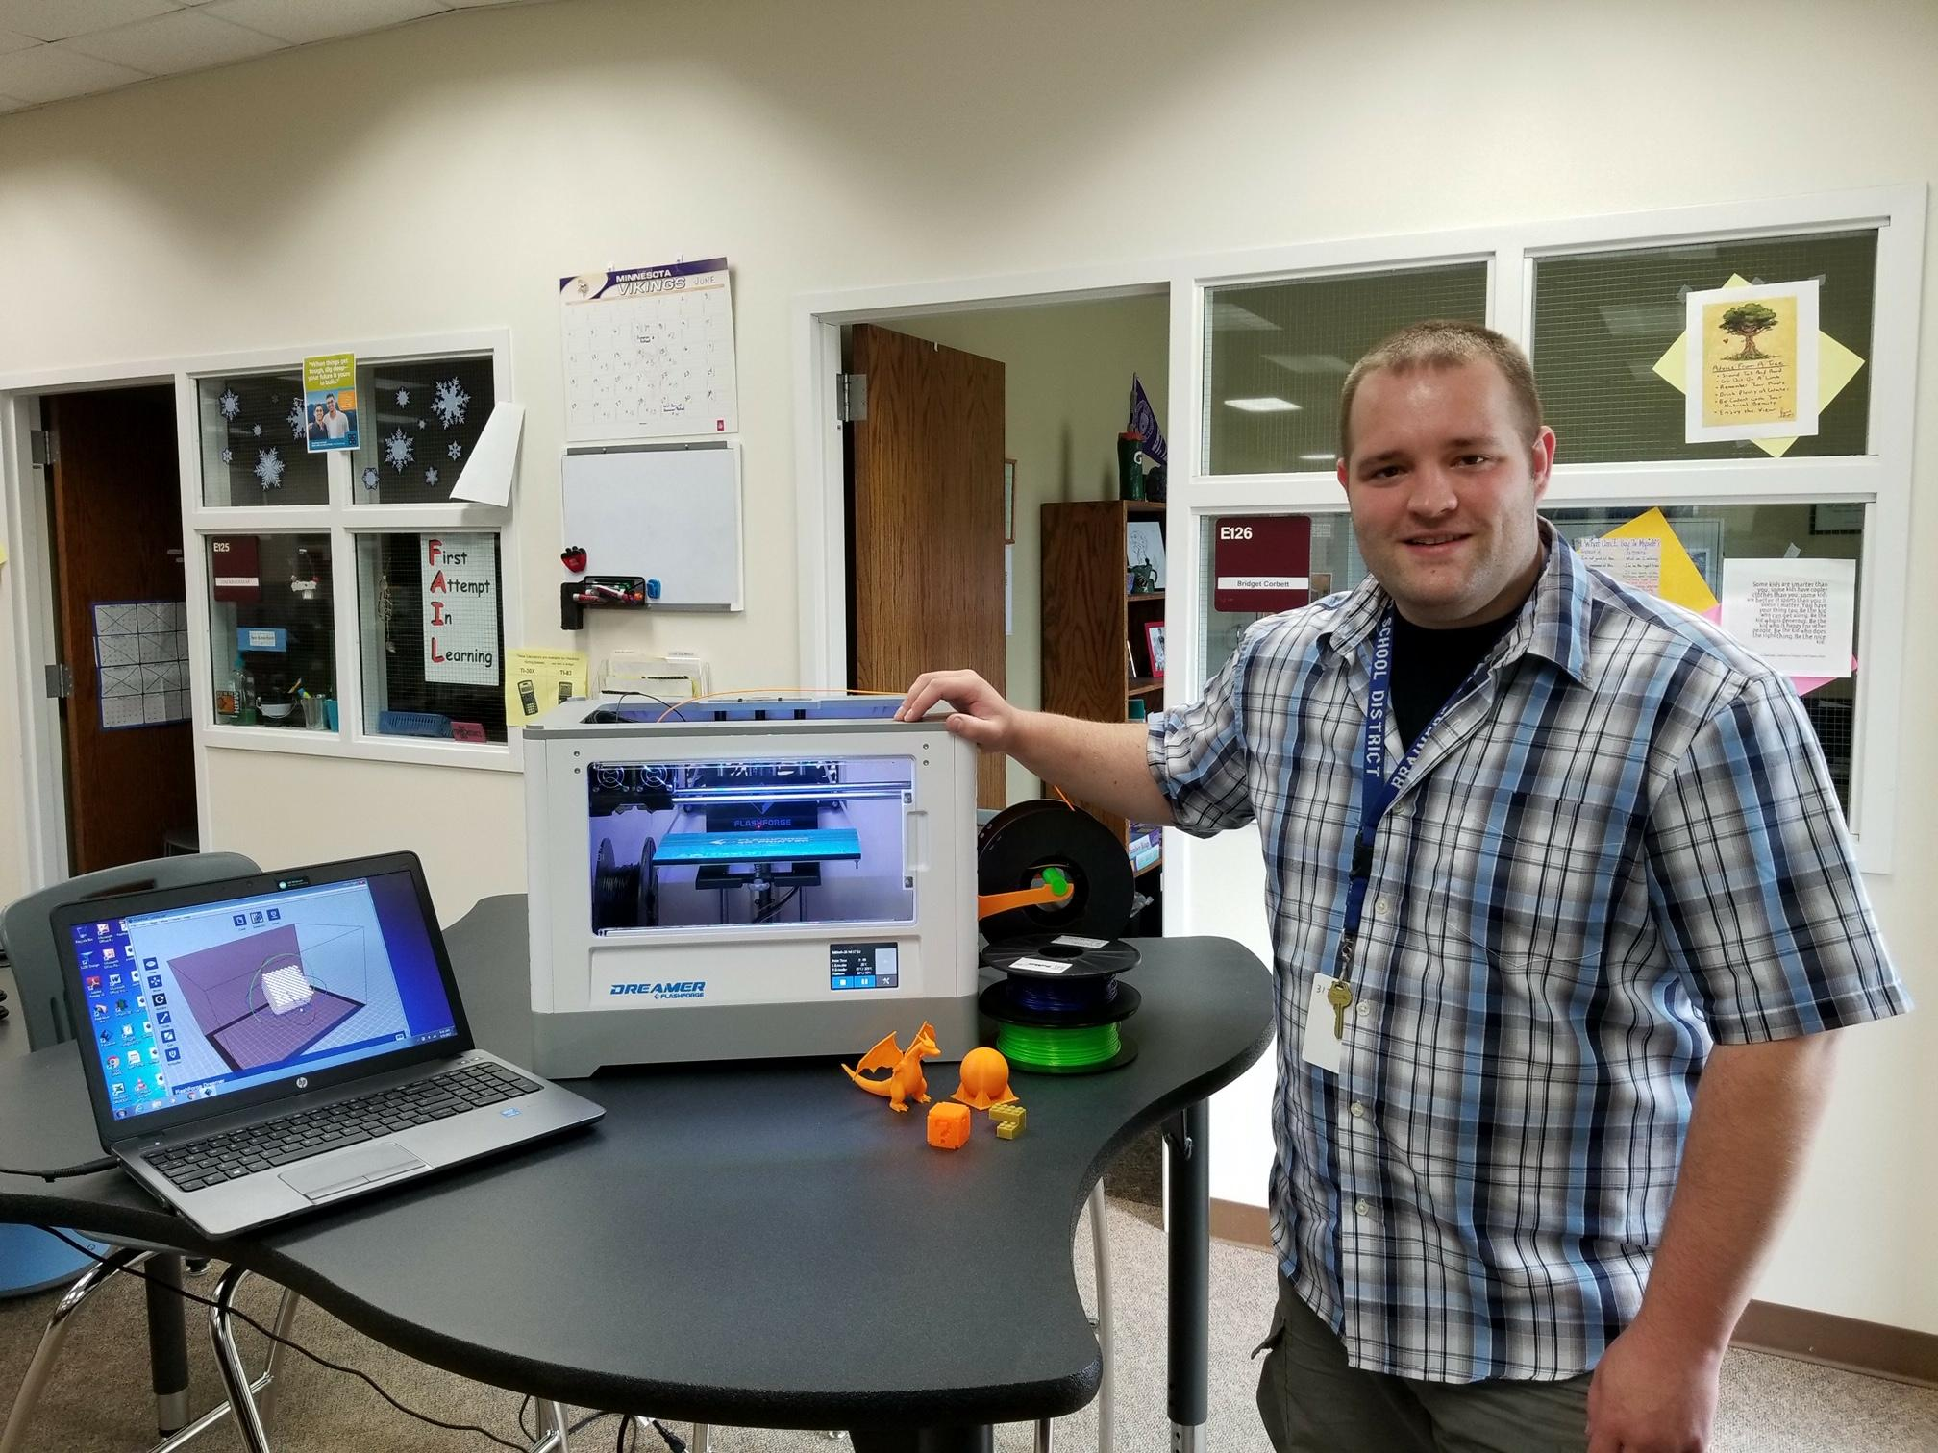
Background
I have worked in the Brainerd School District (Central Minnesota) for 11 years as a system admin
Support 6 k-4 elementary buildings
2 alternative buildings
3d printing specific classes once a week
Enjoy trying new things with students.

Slide 3
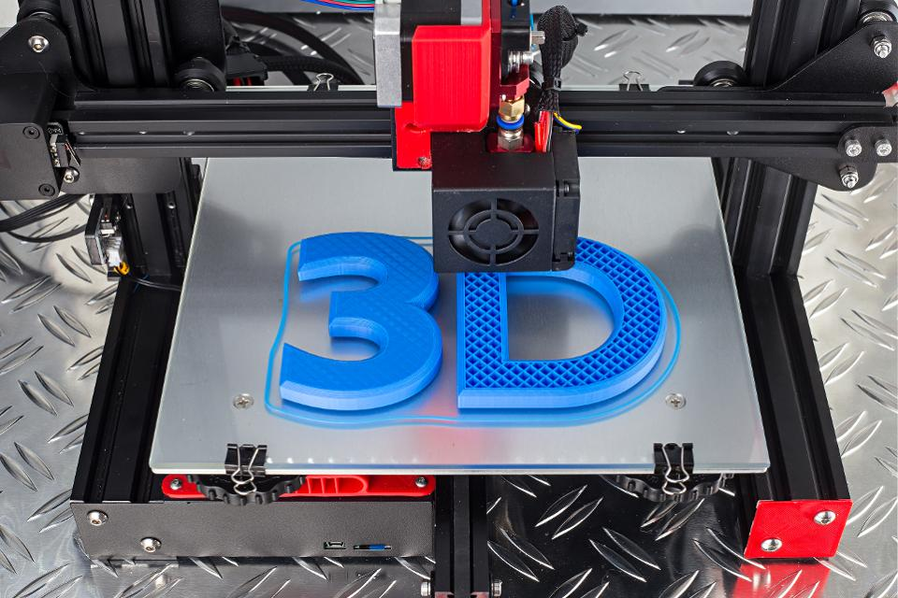
Why 3D printing
Stem Integration
New and fun for kids and teachers
Easy to deploy and support
Low Cost!!
Wow factor
District use cases
FUN!
Notes:
Talk about lenovo 3d printing for keyboard ribbon cable.

Slide 4
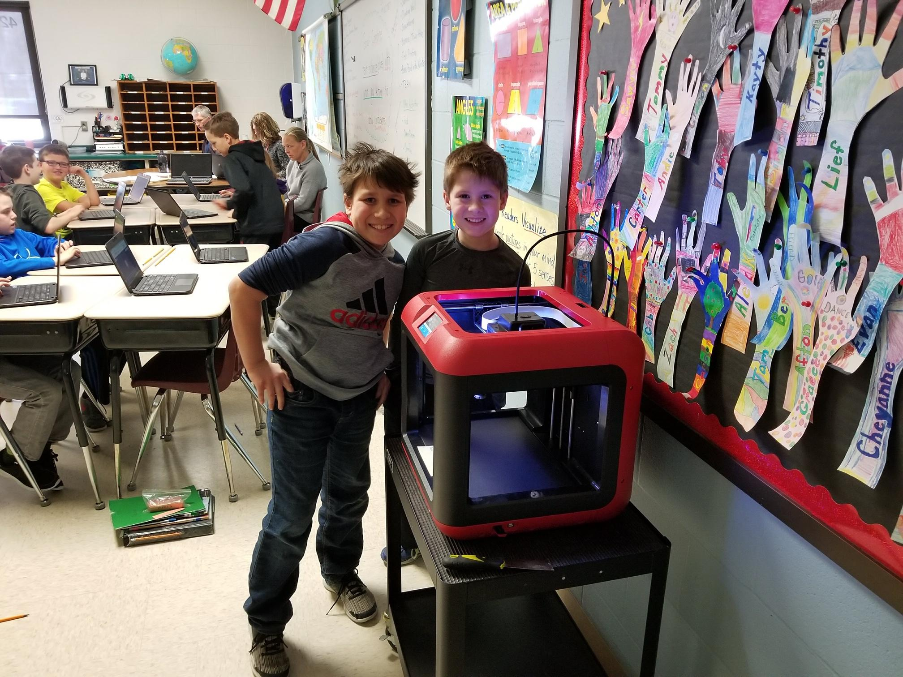
Our current situation
Chromebook carts shared instead of 1:1
2-4 3D Printers are deployed to each elementary
Shared resource cost between tech budget and building
Staff prints 4 items at a time
Around 30 items can be produced per building per day

Slide 5
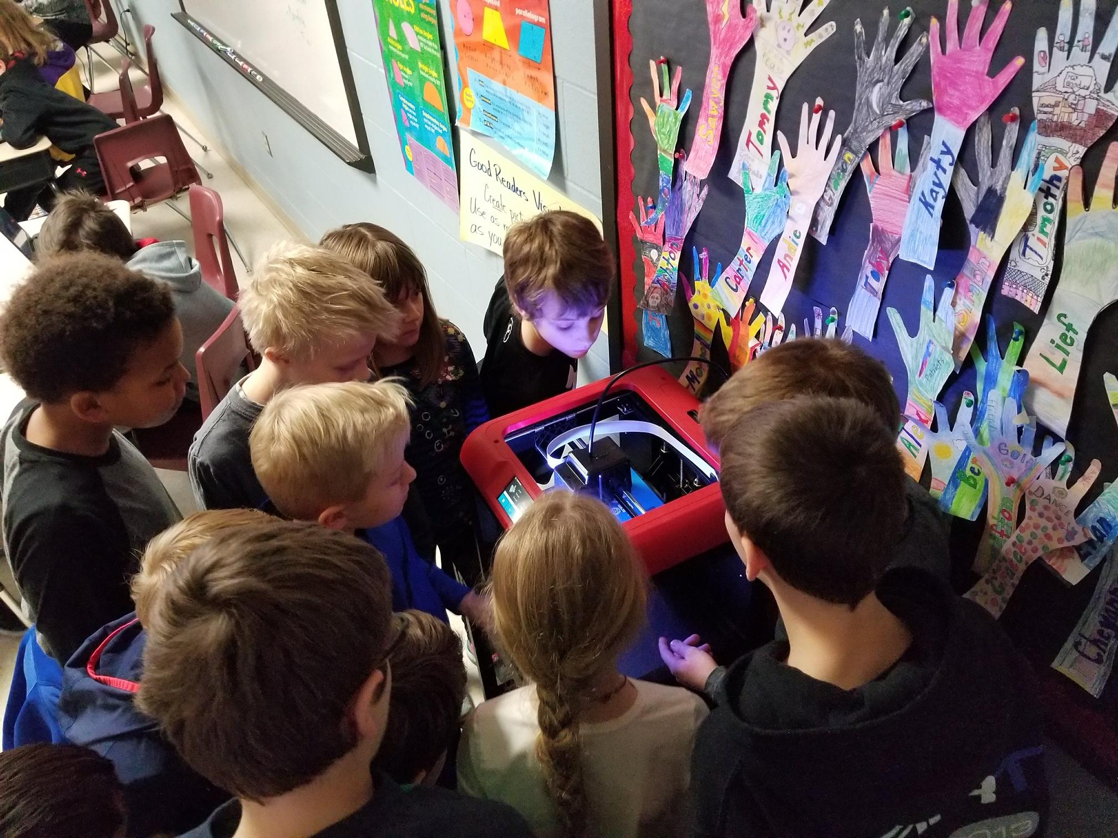
It can be VERY easy.
We are in our 4th year
Flash Forge + Chromebooks + Windows/ Mac Master Laptop
Minimum of 3 Flash Forge Finder units per building
Mobile printer carts
Print Filament Adapter (save $$$ with larger filament)
A complete classroom setup can be obtained for the price of an ipad!
~<$500!!

Slide 6
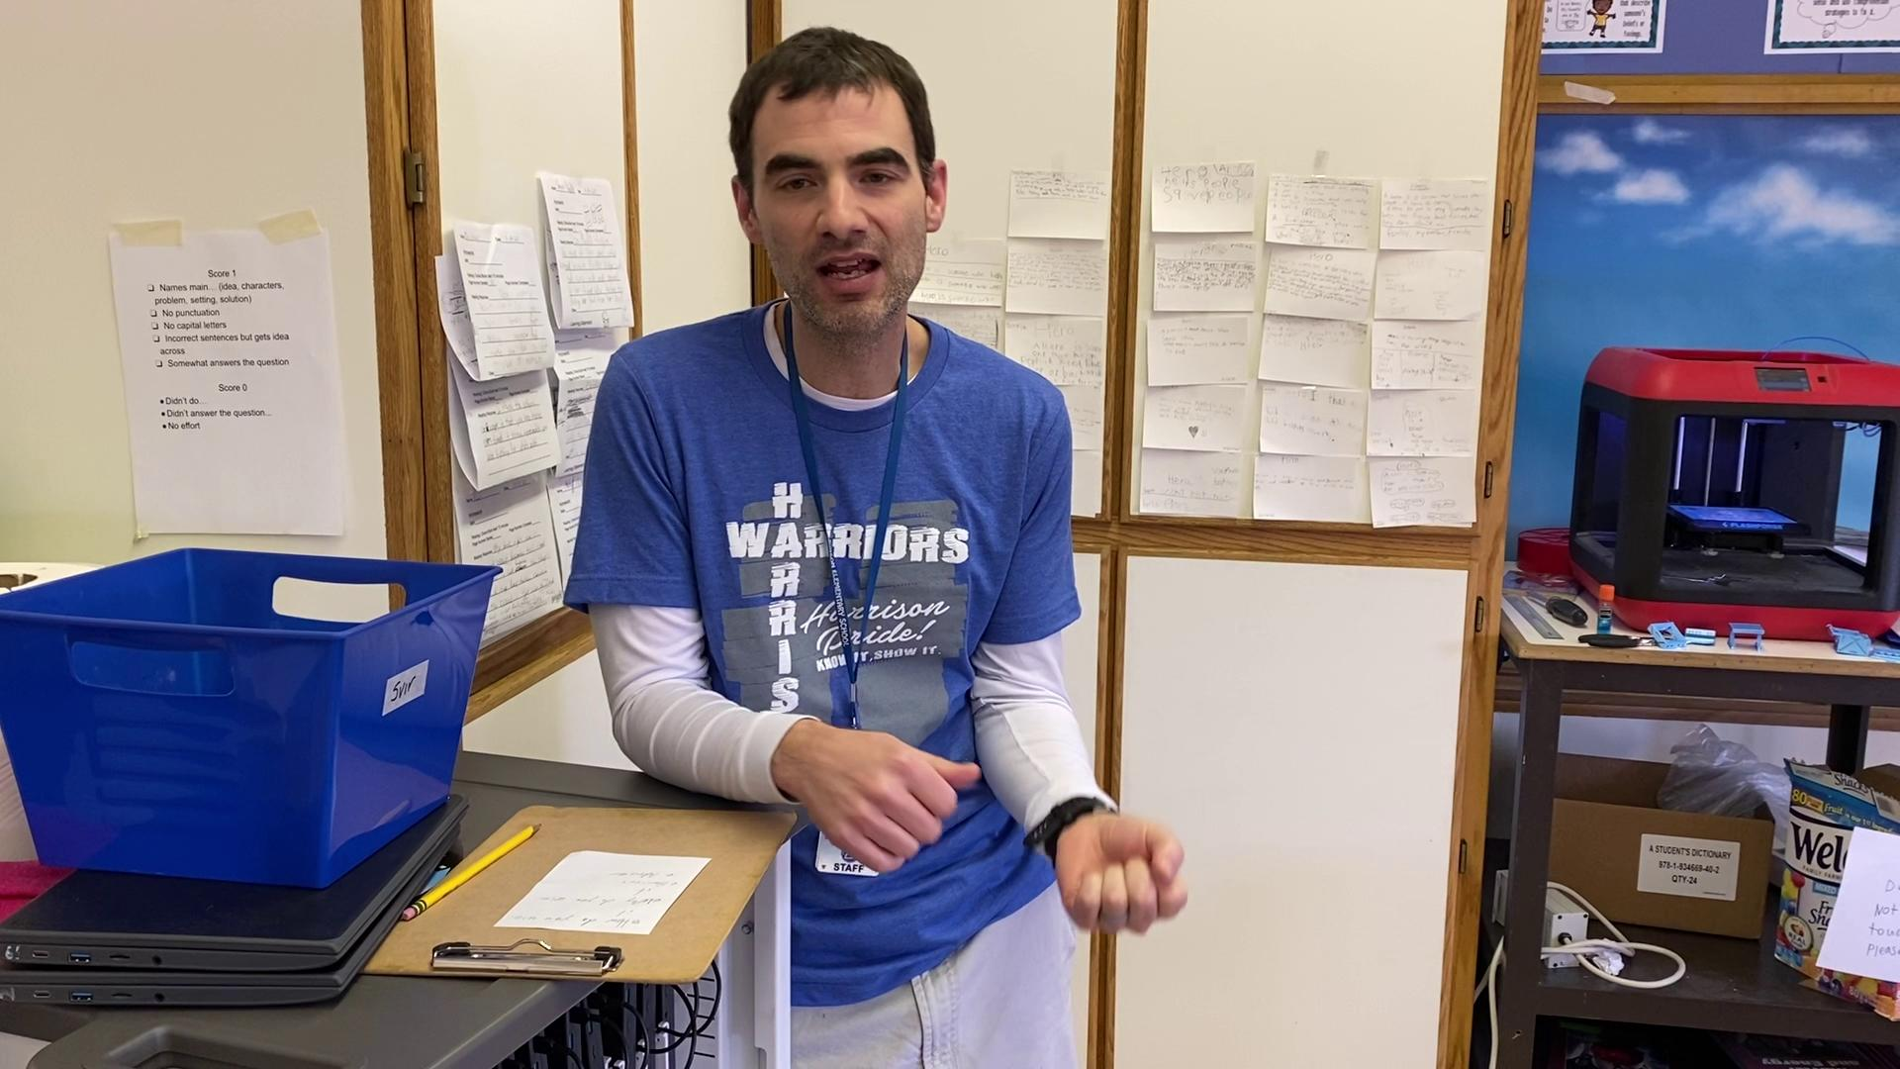
Teacher Interview

Slide 7
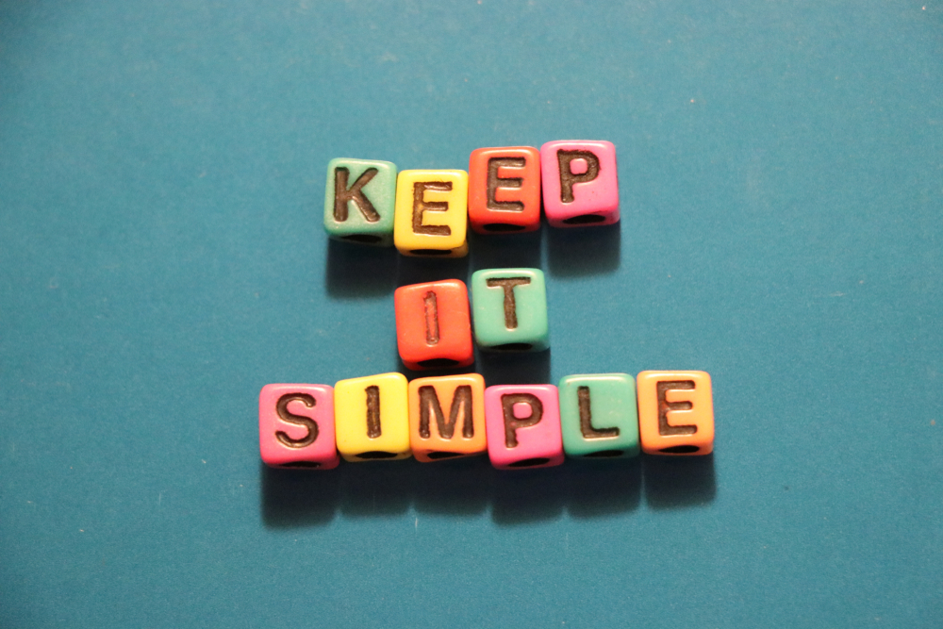
Keeping things simple to start...
Focus on a single vendor and App to print /slice
Work with individuals (integrationists) on a one to one basis
One hour is the most time one will need to get things started per integrationist
Inquire about building investment.
Keep things local to building so there is “ownership” on issues and hardware responsibility.
Make your staff comfortable in the case if something get broken accidents happen!

Slide 8
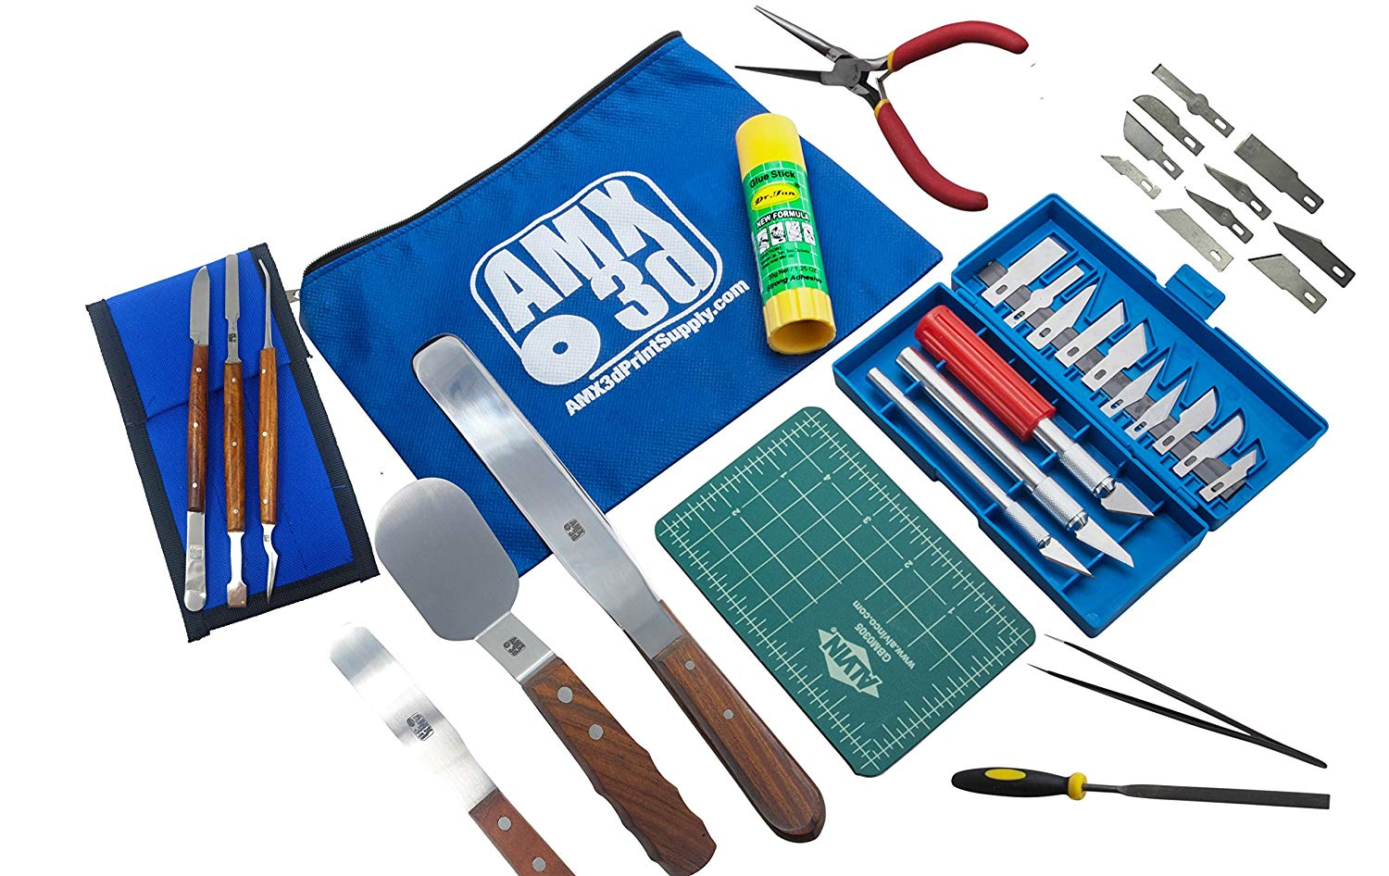
Building a tool kit.
Paint Scrapers
Pliers
Paper Clips
Filament Jam removal tool
Exacto kit (if allowed by school policy)
Hex key set.
Screw drivers
Glue Sticks
Things will go missing. Accept it!
Notes:
Pretty basic stuff. But its much easier to have a good supply of this stuff on hand before you start

Slide 9
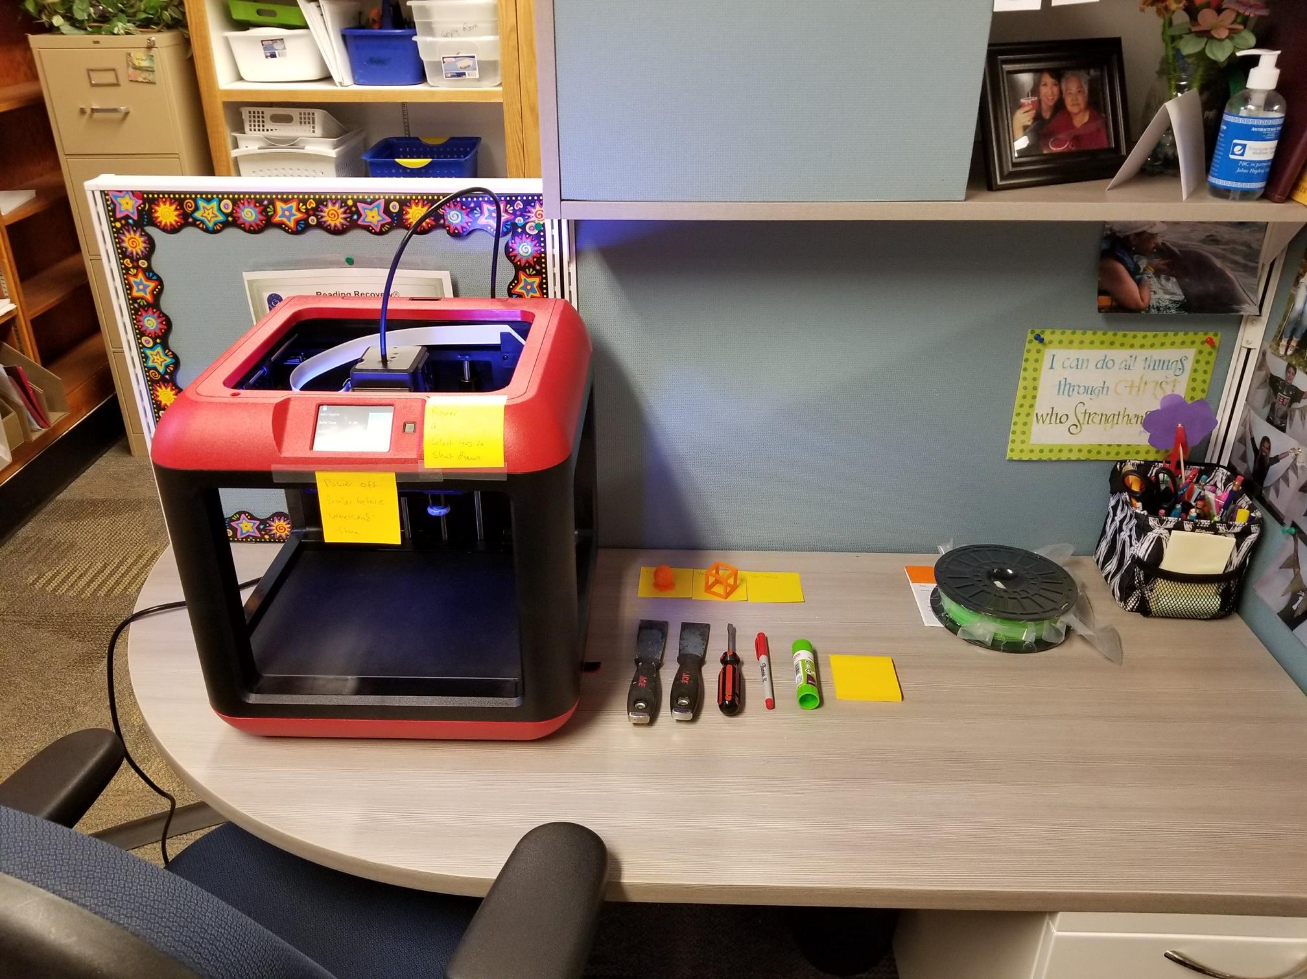
Starting out small.
Less than the cost of an ipad you can start small with a single class room.
300 -400$ printer
100 $ for 5 rolls of filament
50 $ in USB Sticks
50 $Glue sticks and supplies (build plate tape etc)
50$ toolkit
All for the price of a single ipad!!
Notes:
Identify teachers who are comfortable trying new things, Talk about making mistakes is how we learn!

Slide 10
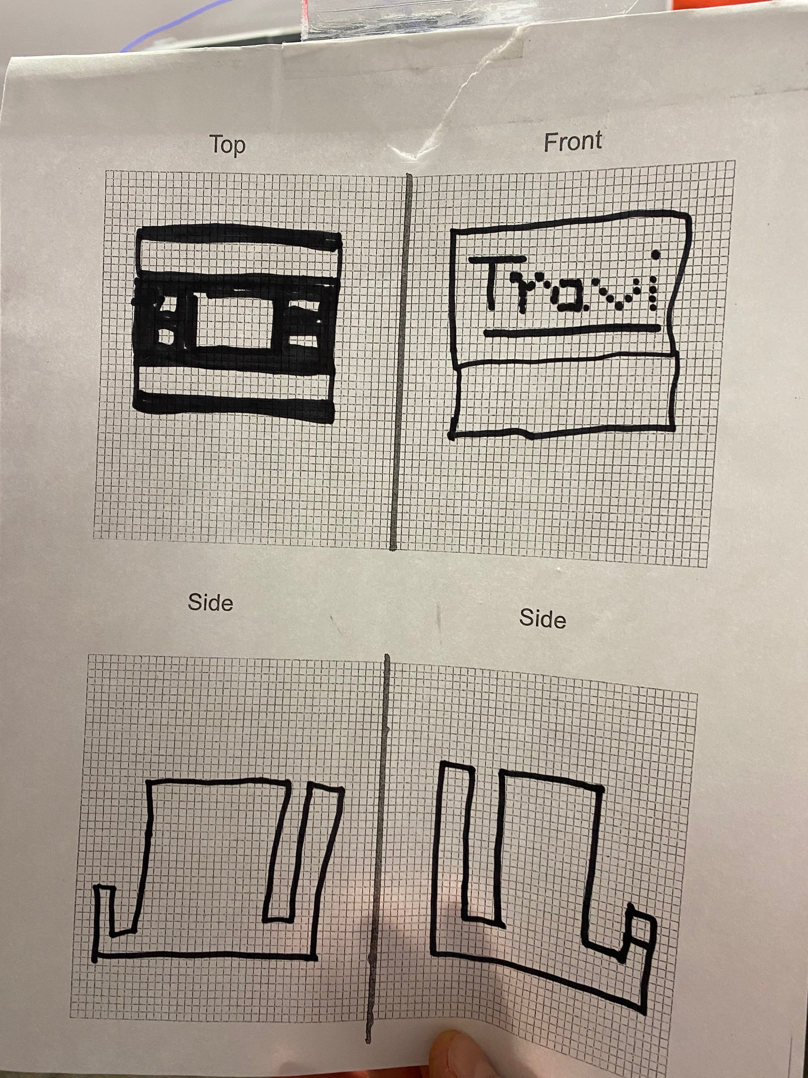
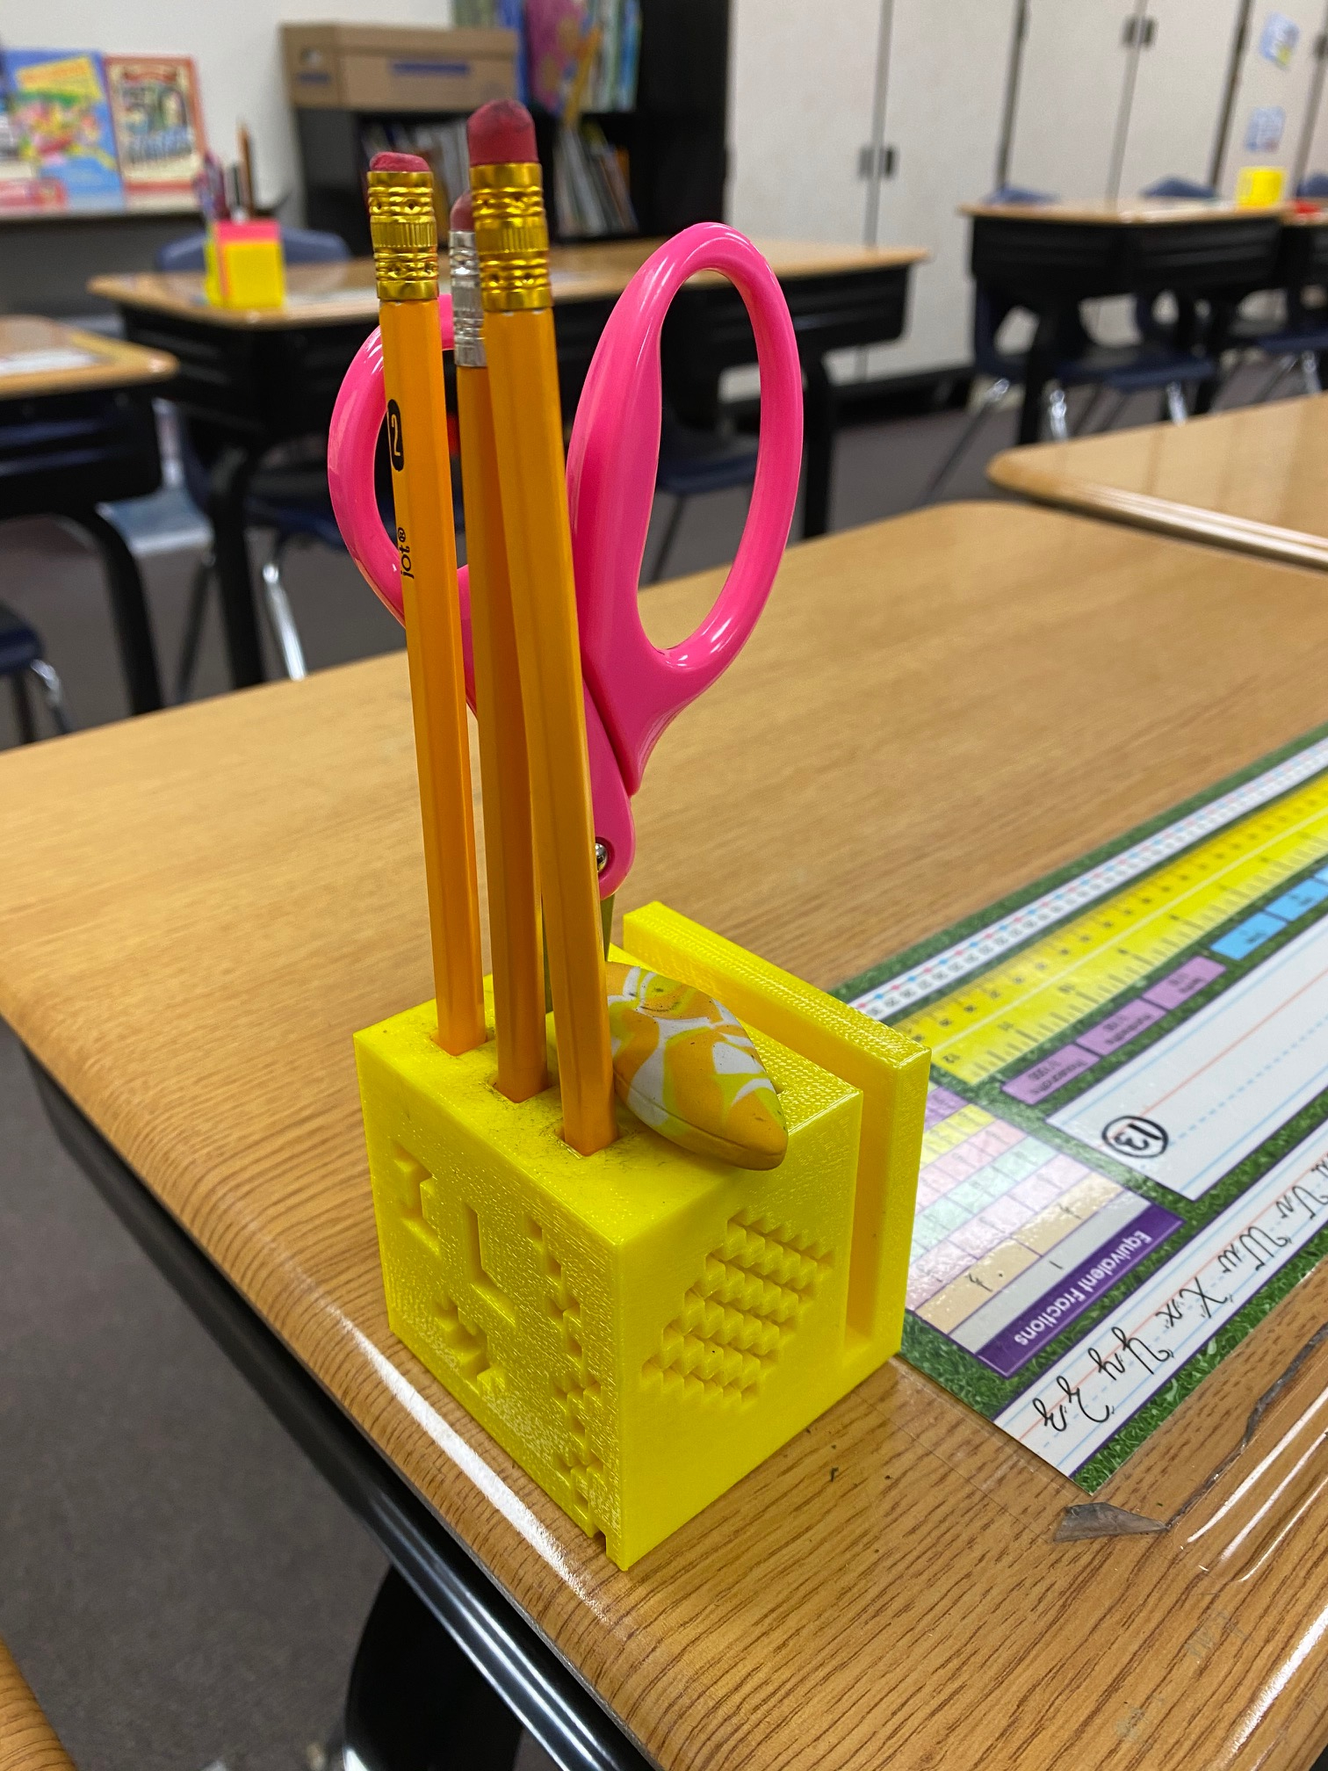
Pre Design
Pre planning is one of the most important parts of the process
Our teachers utilize unit cubes and graph paper
When things do not work as planned the student can revisit
Their plans and make adjustments
Notes:
Talk about graph paper projects. A class of 30

Slide 11
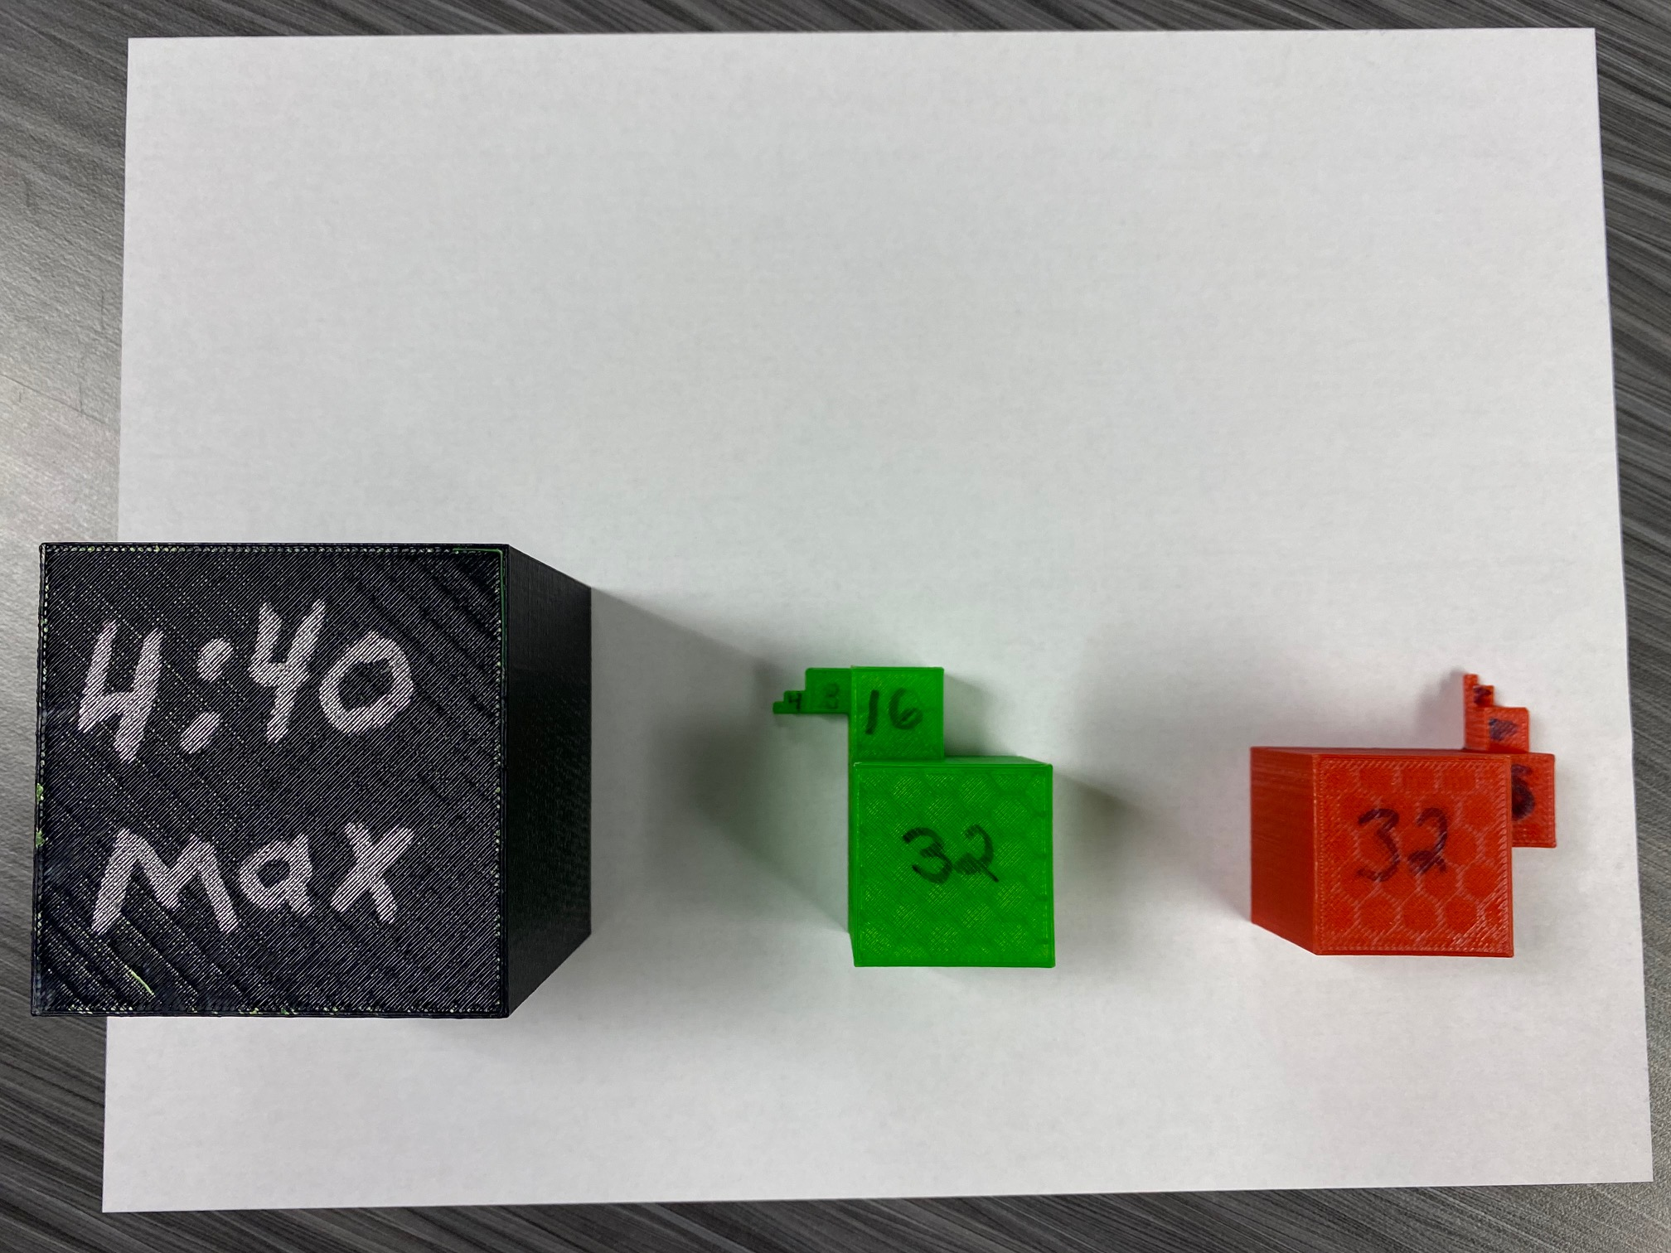
Start out by drawing or graphing
Unit Cubes
Design and print some demo cubes to show kids
What size their items will be.
Visualizing before printing saves time and problems

Slide 12
Graphing or drawing it
Talk about dimensions in lesson plans
Talk about the sides of an object
Have the students plan by drawing all sides

Slide 13
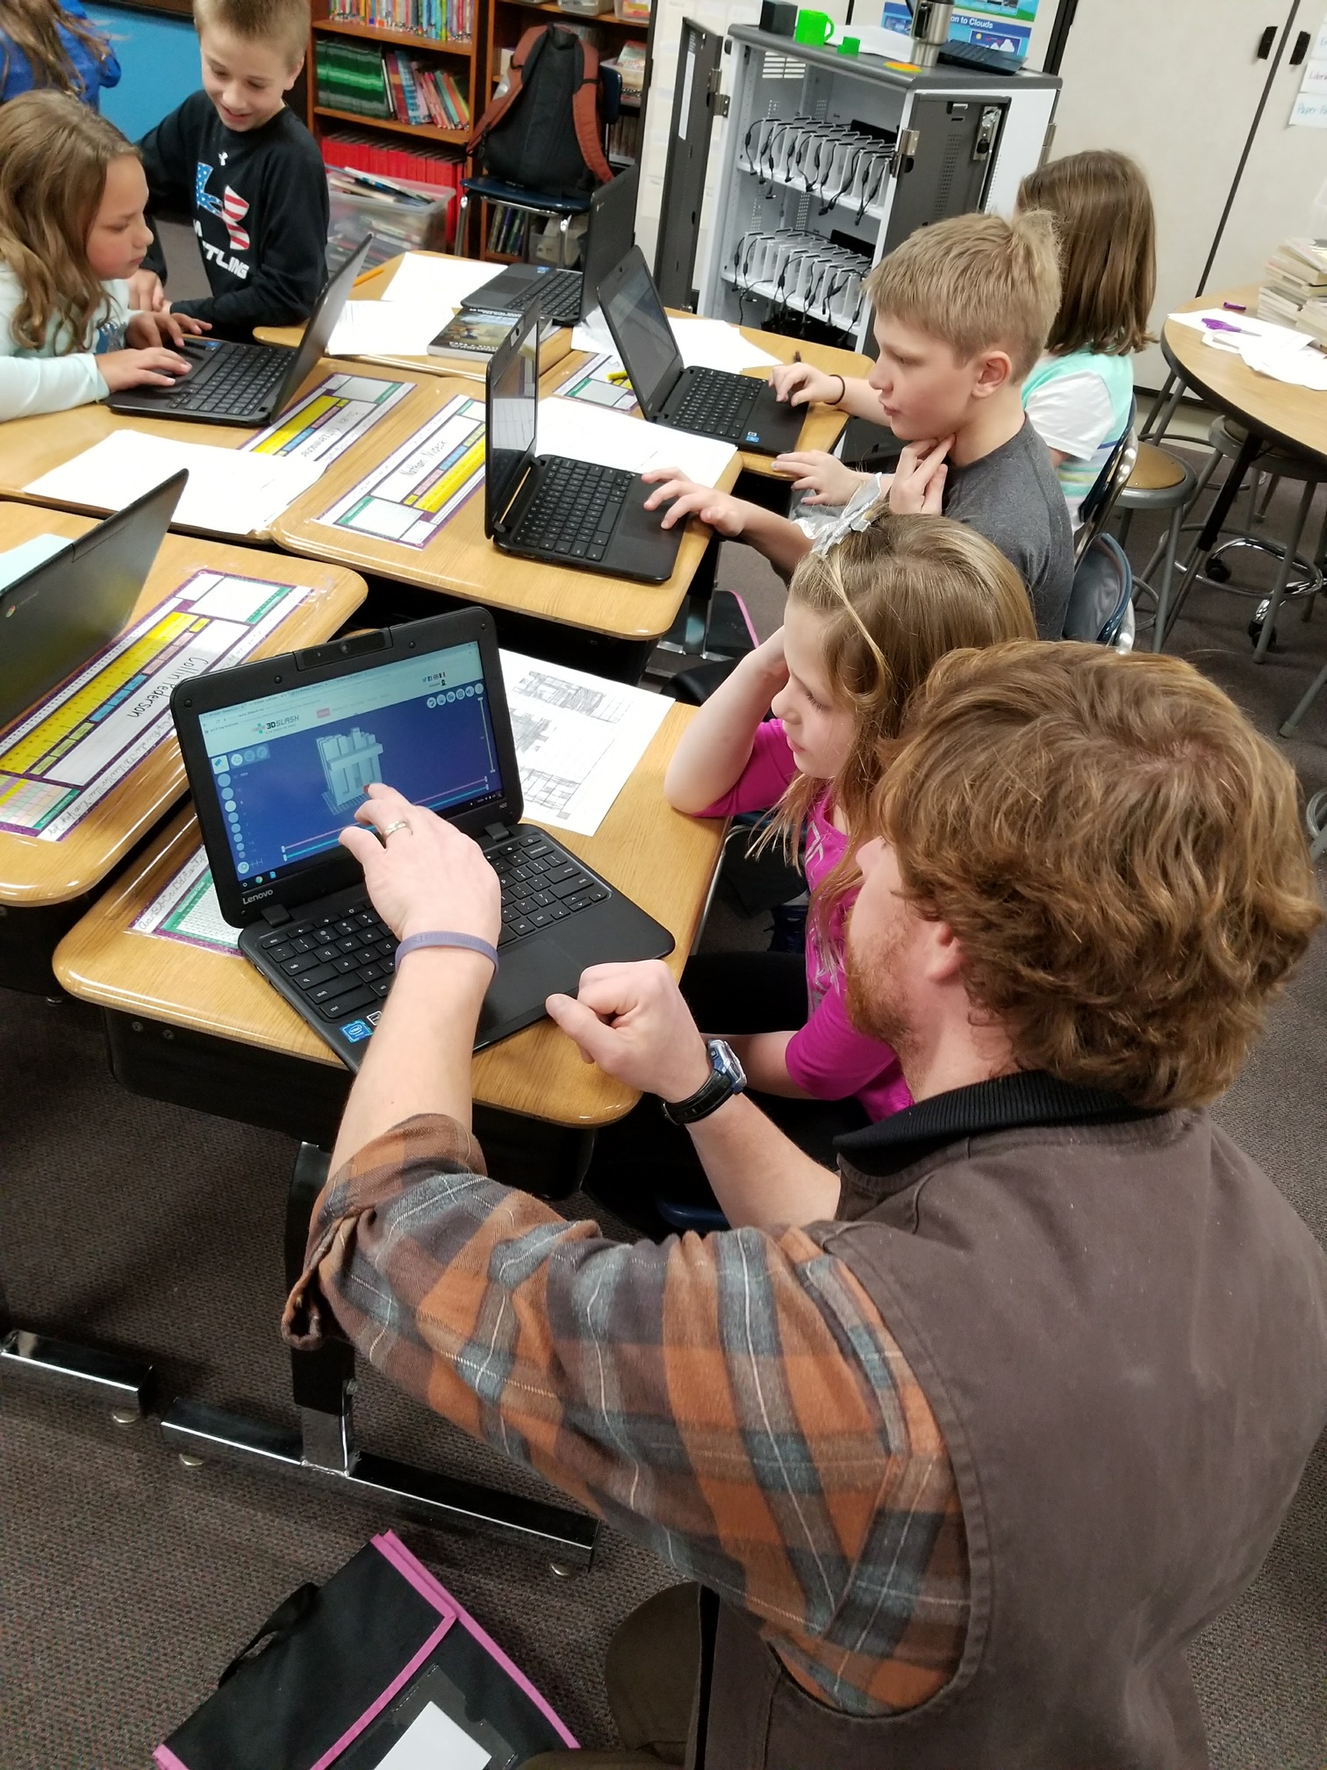
Applications
Everything the student creates can be done on a chromebook !
Notes:
Now that plans are established its time to jump into the design apps!

Slide 14
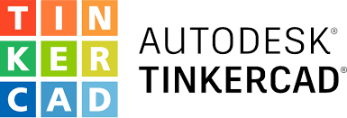
Applications we use
100 percent web based!
Free version of 3d Slash 90% use case. Fast, easy and quick to use
Tinkercad (next step) Students help each other with the built in tutorials
Light touch approach. (let the students find out how things work naturally)
***Do not be afraid to take advice from kids. They are digital natives and pick up on this quickly**
( learn more from them then many online tutorials and guides!)

Slide 15
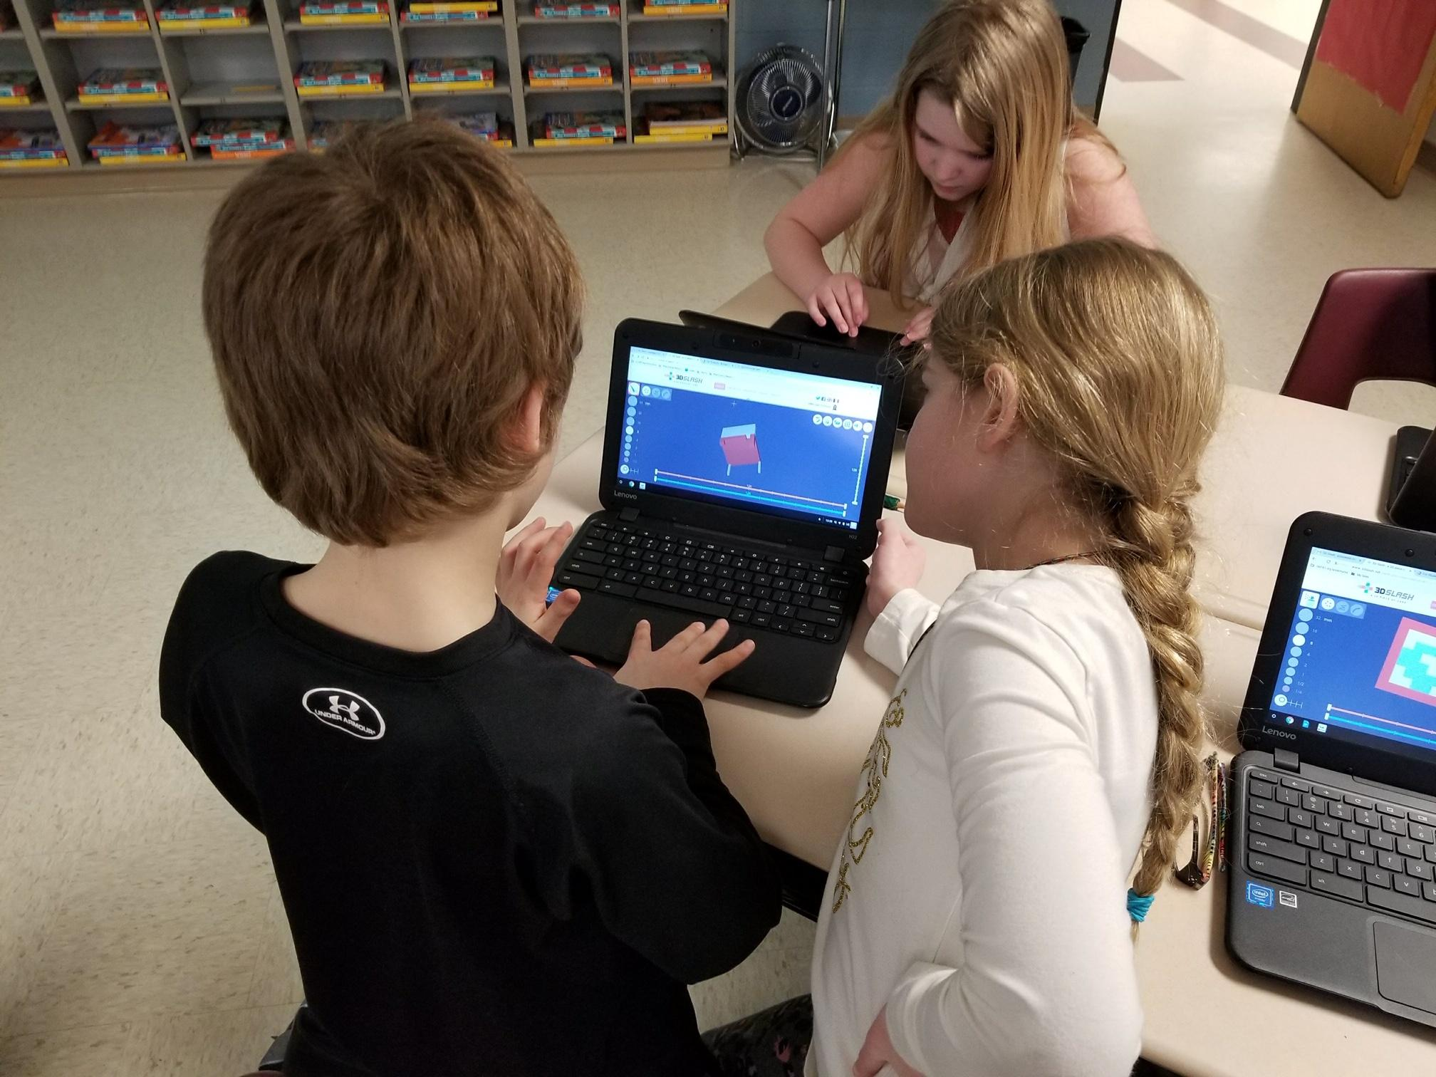
Using 3d Slash
Super simple to deploy and use
FREE version is what we have been using
Small amount of limitations rarely get in our way
The site generates the password and sends it to the students email.
**Make sure to whitelist the 3D slash domain so students get their accounts**
Notes:
It is super basic. But when you are working with large groups of kids and limited to 1 hour blocks. 3d slash is a very quick item to support

Slide 16
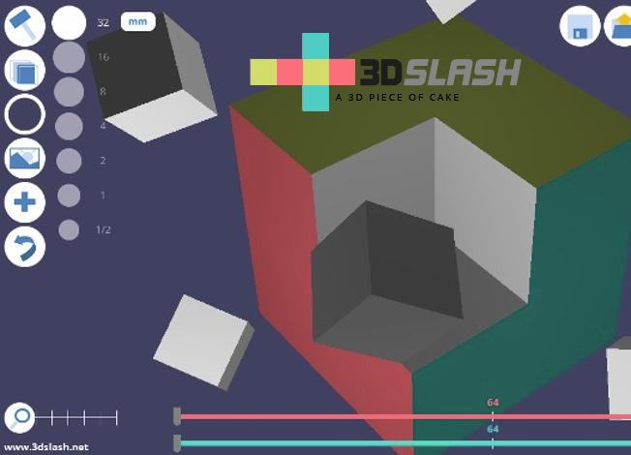
Using 3D slash continued
Jump right in.
Right after a student enters their email it lets them and has a quick tutorial.
I recommend they have the first session as experimental time. This will help them with future questions
Start with a blank slate or cube that is the question…
Create something.

Slide 17
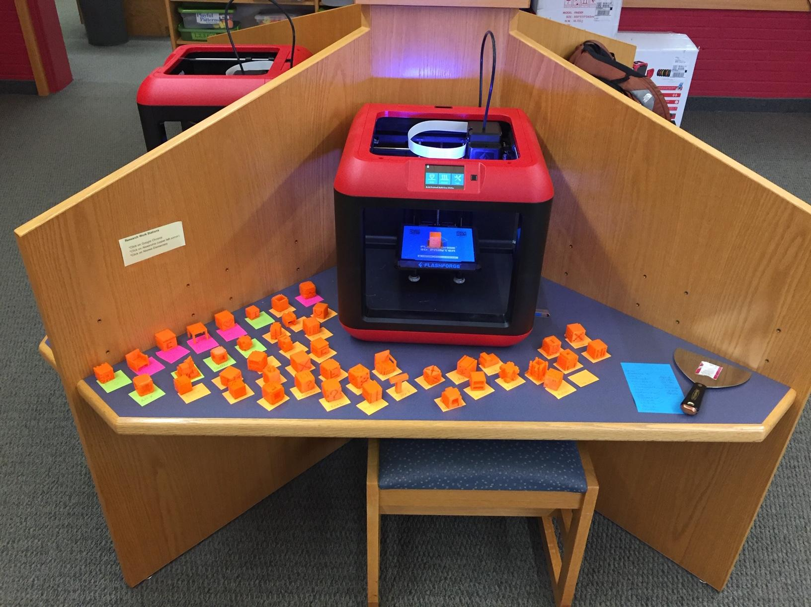
Using 3D slash Contd. (EXPORT TIME)
All 3D printer slicing apps require .STL (standardized 3d model) files.
From 3d slash the student can export as .STL but must wait 60 seconds.
This is an eternal time for them :) (it can be fun to see the reactions)
Raise their hands when timer is up and teacher will collect files via USB stick from chromebook.
Teacher will rename file before downloading to usb.
Plan a strategy (printing day or time for the building)

Slide 18
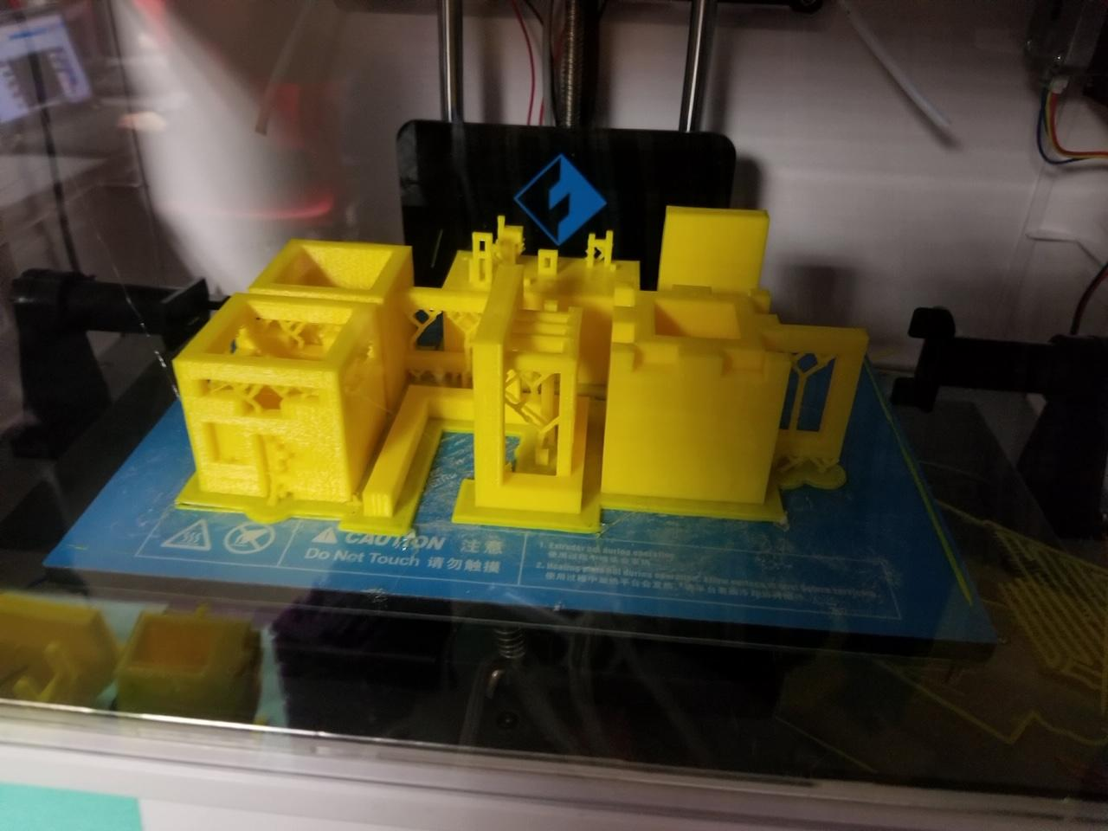
Slicing your prints in FLASH PRINT
After staff has collected the .STL files from student chromebooks on to USB drives. The files need to be sliced.
A PC or Mac can be used with Flash Forge’s Flash Print app
Teachers will prepare the print by importing 4-6 student .STL files into each print build
In the app you can “slice” a class of 30 print run onto a USB stick in about 20 minutes.

Slide 19
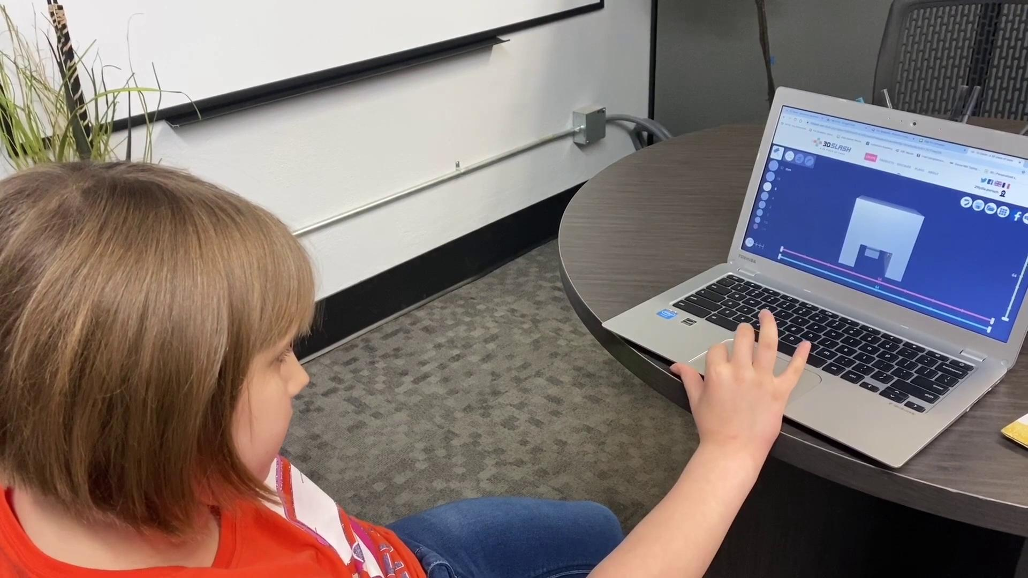
Student Interview

Slide 20
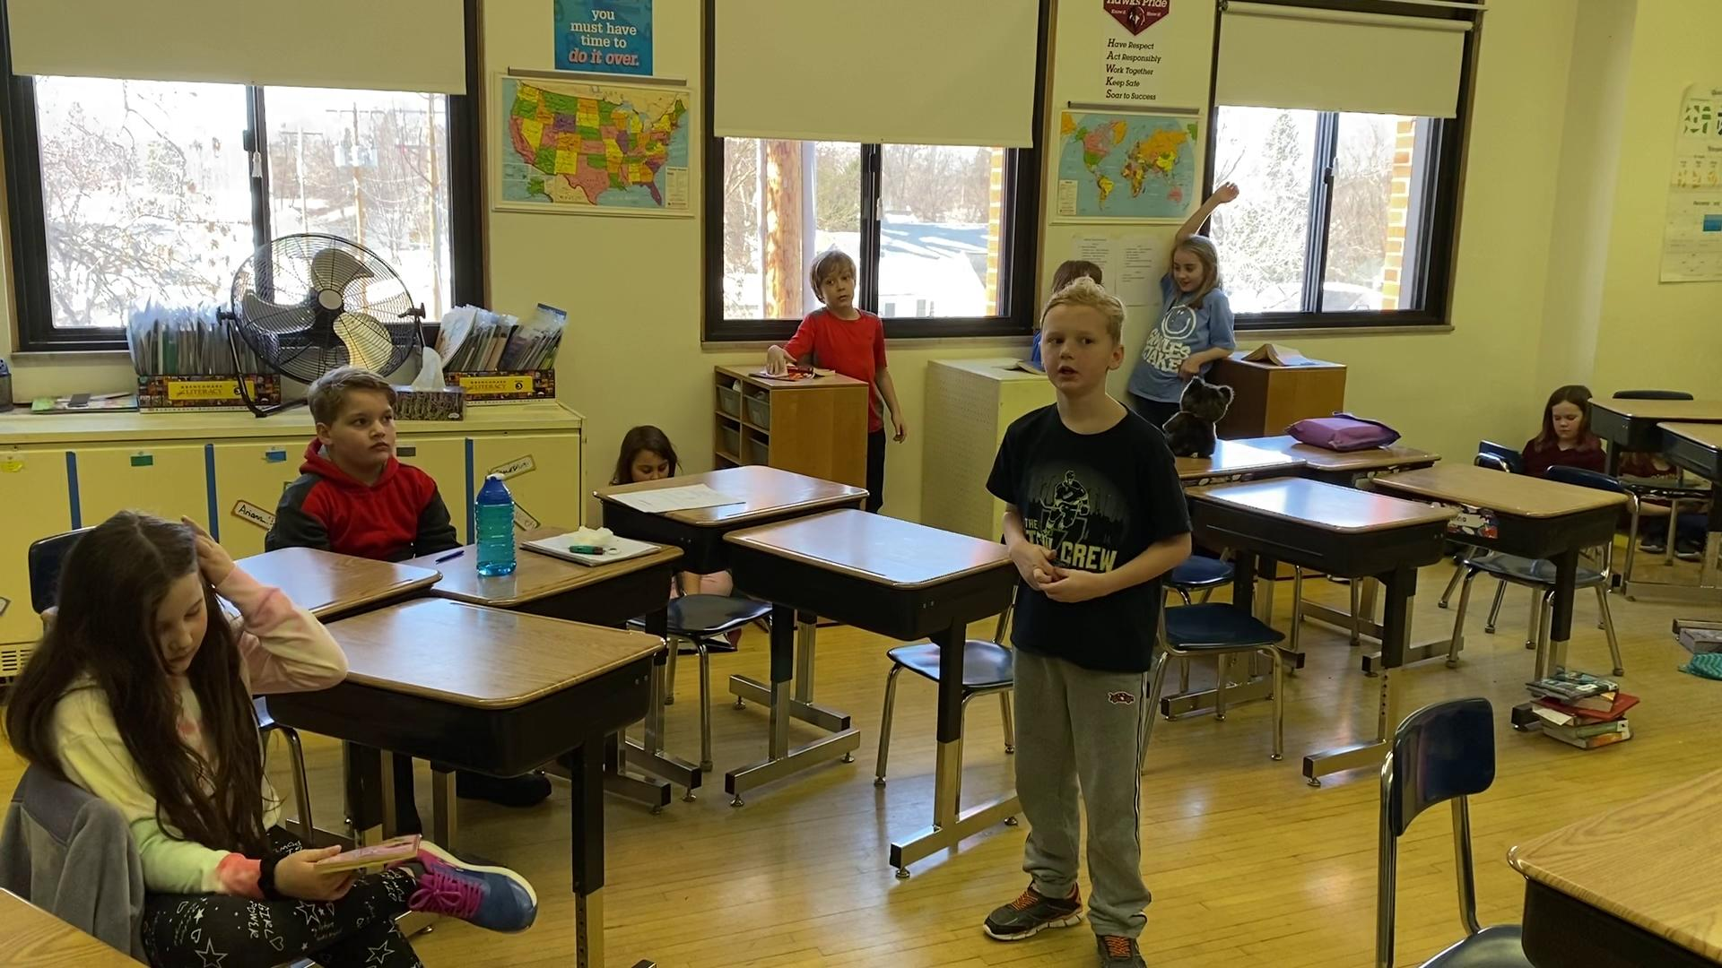
Why do you like 3D Printing?

Slide 21
Where do you operate your 3D printing process?

Slide 22
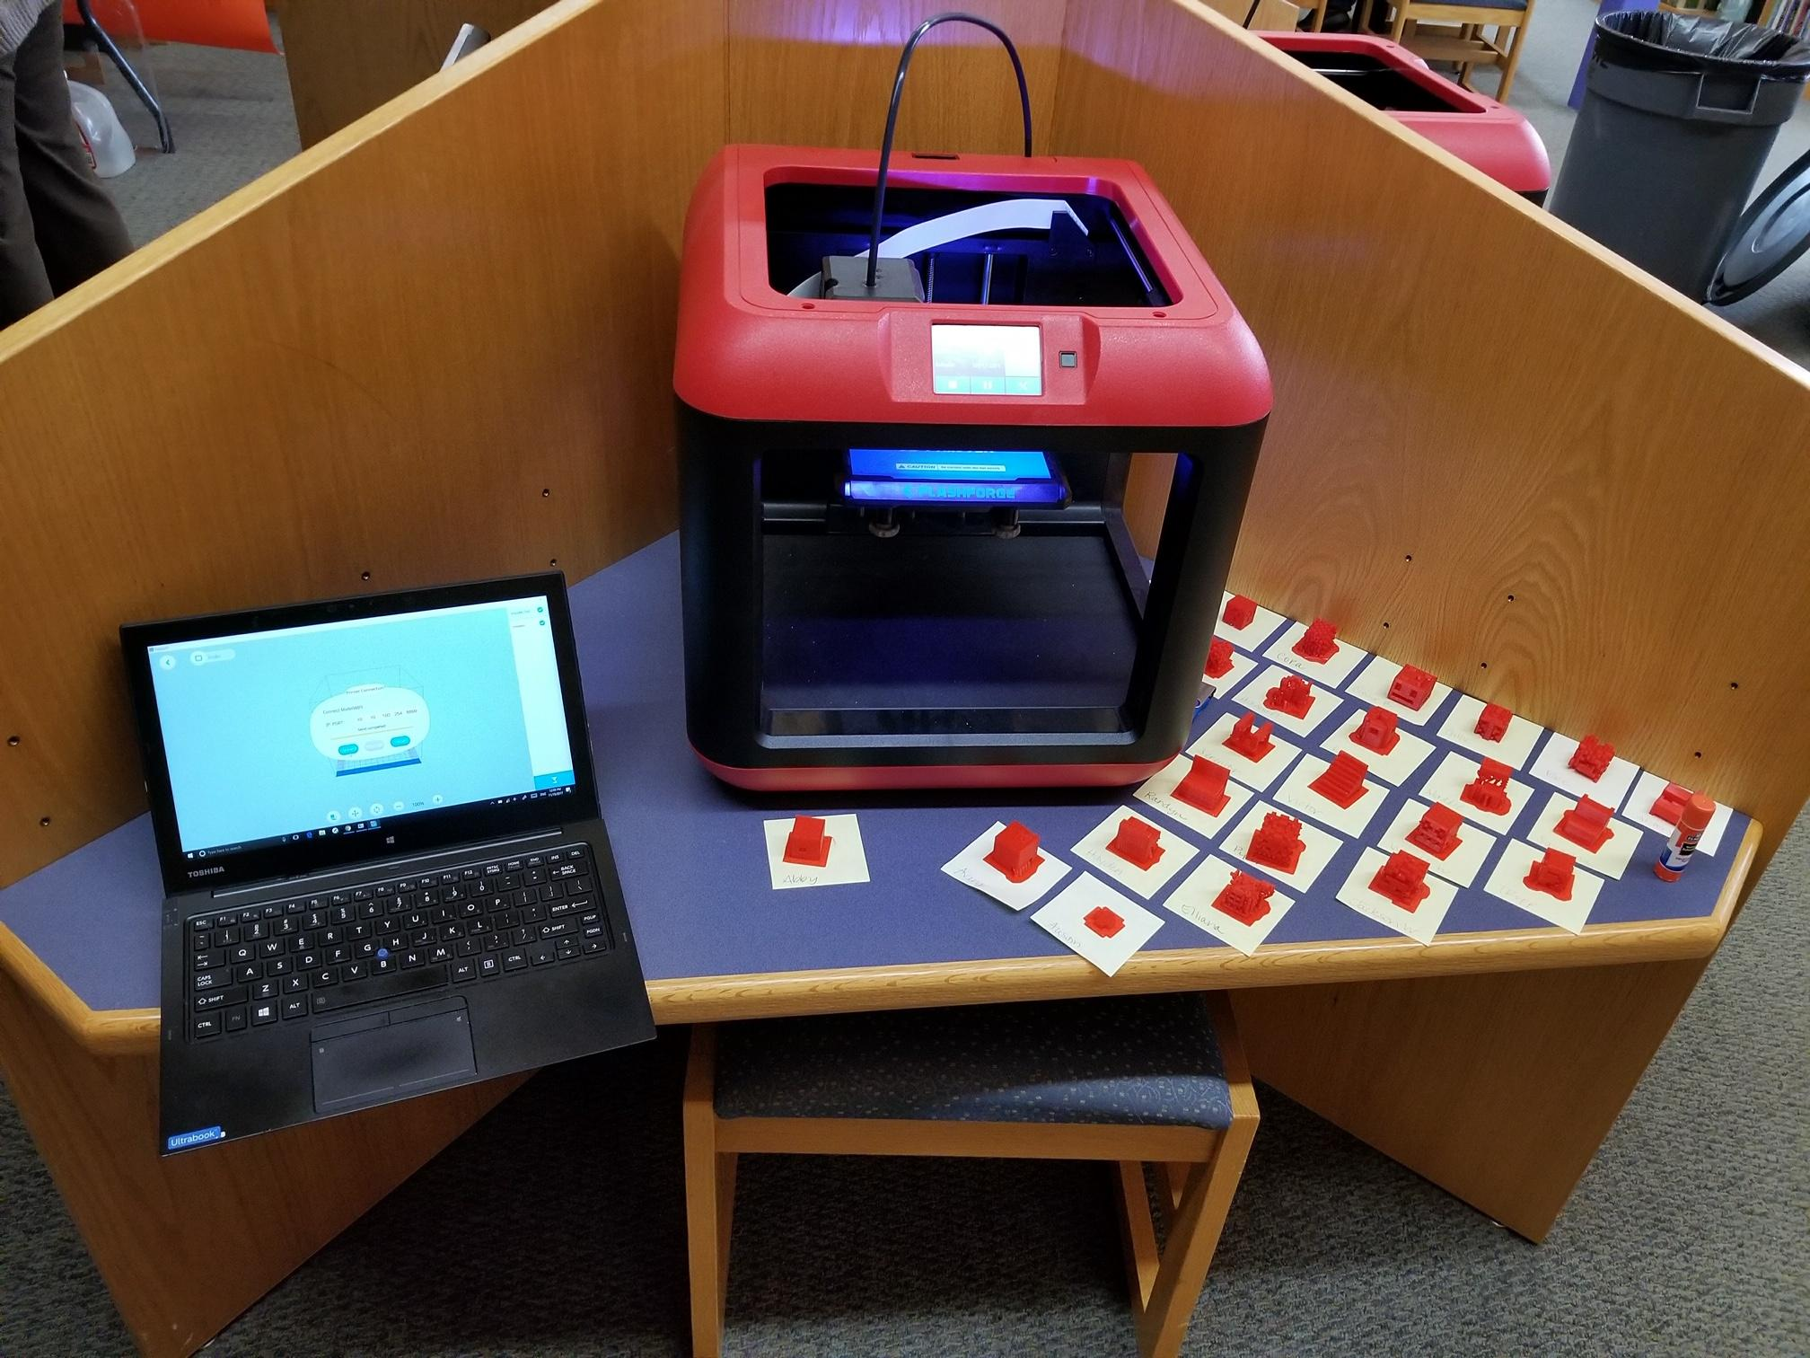
Organizing your printing strategy
Building specific
Number of units
Location
Recommend 4 items per print on a Flash Forge finder
4 items take 2-4 hours.
3 printers can do 30 in a day with minimal supervision

Slide 23
Create a public spot in the media center
Set up an area where other classes, parents and volunteers can see the printing process.
Units are actually quiet enough that they do not create an audible disruption
Choose an area where there is proper supervision.

Slide 24
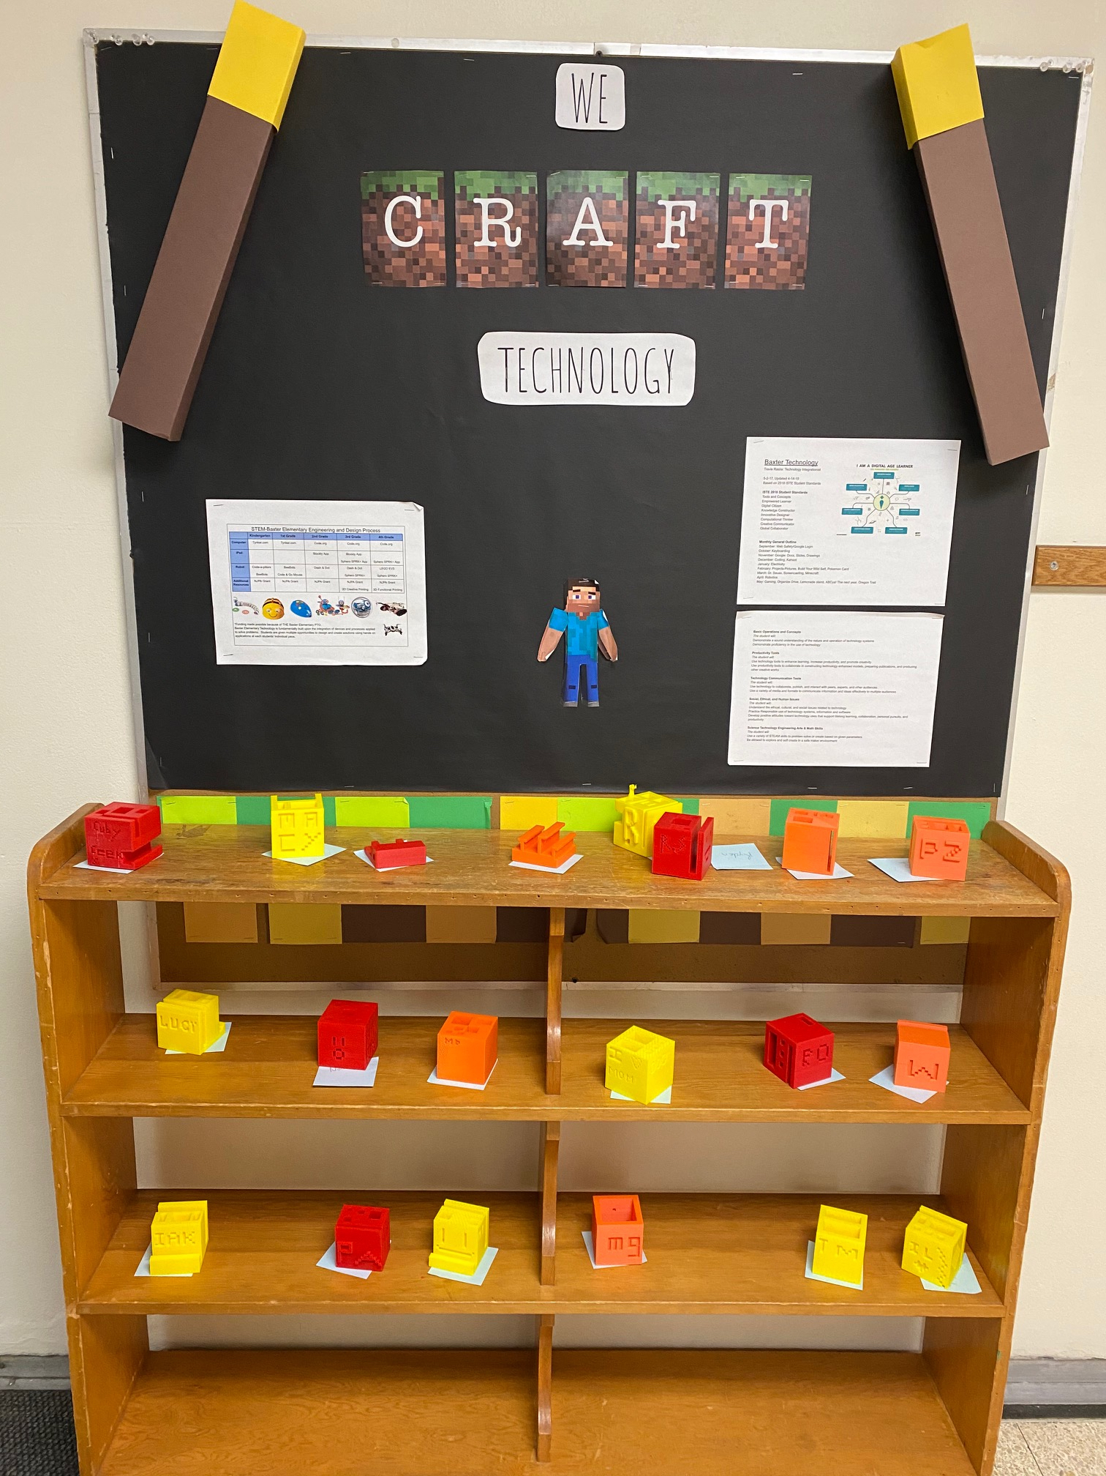
Public Displays in hallway
In some of our buildings we have shelf in the hallway so students can see what has completed printing.

Slide 25
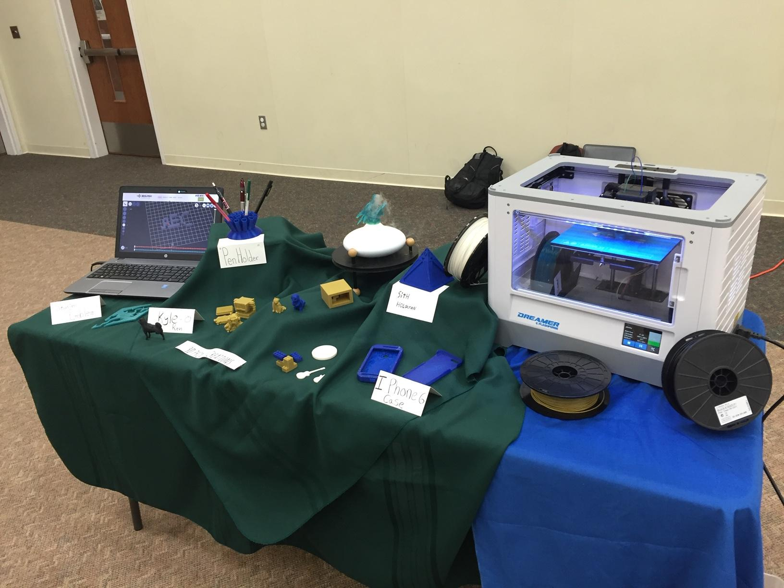
Public Display
The best way to keep support, motivation and inspiration is showcasing your classrooms creations at public events
Parent groups and public see whats is happening and provides ongoing support.
When parents and community members see what happening there are increased donations and grant approvals!

Slide 26
Problems

Slide 27
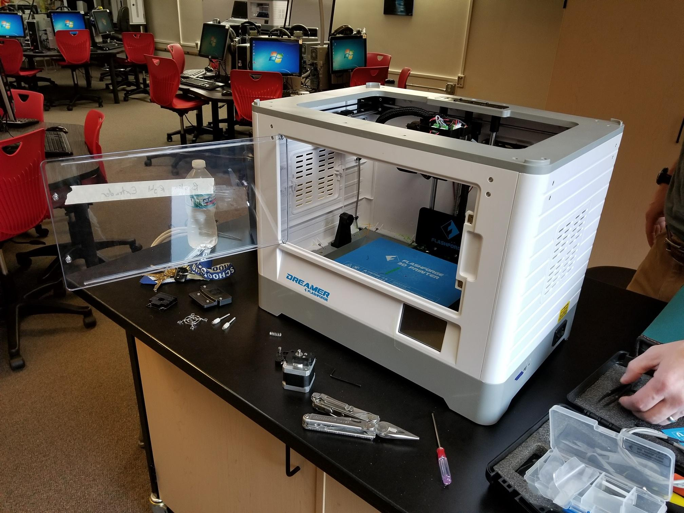
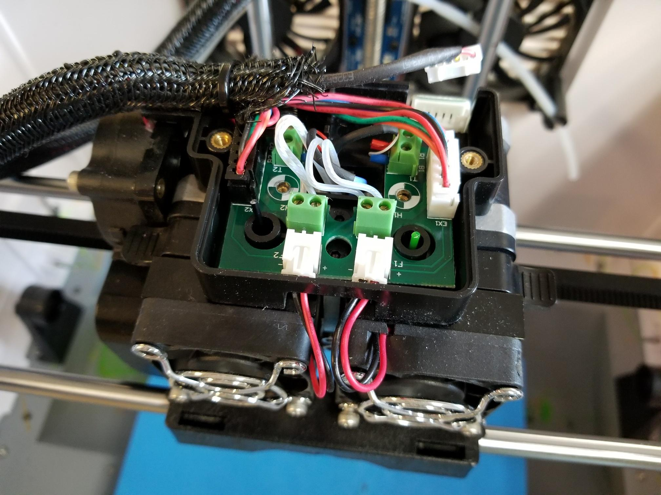
Breakdowns
Breakdowns are normal!
Due to cost of these units you can go one of two directions
-Backup units just replace and keep old units for donor parts
-Work with student chromebook repair teams on printer refurbishment
(we have not done this yet but it is a goal..)
Build a toolkit before you start so you are ready to fix!

Slide 28
Struggles We have encountered..
Lulzbot Taz was a complete nightmare. Larger filament size. CURA is a hit or miss
Flash print vs vs simplify3d
Deadlines (have traveling printers available)
Saving the wrong kind of file or data type
Using other classrooms units during breakdowns or deadlines.

Slide 29
DEMO TIME!

Slide 30
Questions/ Group Discussion
What units do you use in your district
What software do you use
Budgets
Grade levels
Integration with makerspaces and curriculum
Busting through road blocks..

Slide 31
Links to products we use
Flash Forge Finder $349https://www.amazon.com/gp/cart/view.html/ref=lh_cart_vc_btn
Hatchbox PLA Filament $20-30 per roll https://www.amazon.com/HATCHBOX-3D-Filament-Dimensional-Accuracy/dp/B00J0GPC80/ref=sr_1_4?crid=U4G7RMBAV0UM&keywords=hatchbox+pla+3d+printer+filament%2C+dimensional&qid=1582923154&sprefix=hatchbox%2Caps%2C171&sr=8-4
Flashprint https://www.flashforge.com/download-center
3D Slash https://www.3dslash.net
Tinkercad https://www.tinkercad.com/
Free Autodesk Products for EDU use https://www.autodesk.com/education/free-software/featured

